Slide 1
Workshop: Computer Networks
Jon Chippindall
www.primarycomputing.co.uk
CAS Master Teacher
@drchips_

Slide 2
Computing national curriculum 2014
understand computer networks including the internet; how they can provide multiple services, such as the world wide web; and the opportunities they offer for communication and collaboration
use search technologies effectively, appreciate how results are selected and ranked, and be discerning in evaluating digital content

Slide 3
Session aims:
Increase subject knowledge around computer networks
Provide ideas for activities to teach POS statements

Slide 4
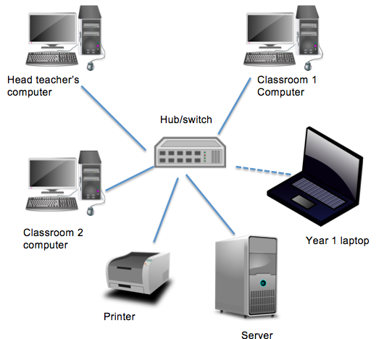
‘Understand computer networks’
Server: Provides services on the network, such as logging in, running programs, saving.
Clients: Access services.
Hub/switch: Connect everything together.
Why? Share services: Printers/internet, programs, saving.
Activity: Network hunt

Slide 5
Activity: modeling the internet
Websites available
www.bitesize.com/shadows
www.youtube.com/shadows
www.shadowlantern.com
Notes:
Make badges
Print web pages
Get paper for messages
Scissors
https://www.youtube.com/watch?v=WwyJGzZmBe8
Traceroute

Slide 6
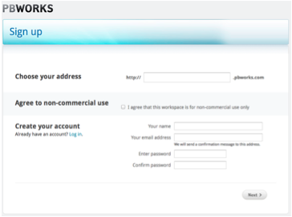
‘The opportunities they offer for communication and collaboration’

Slide 7
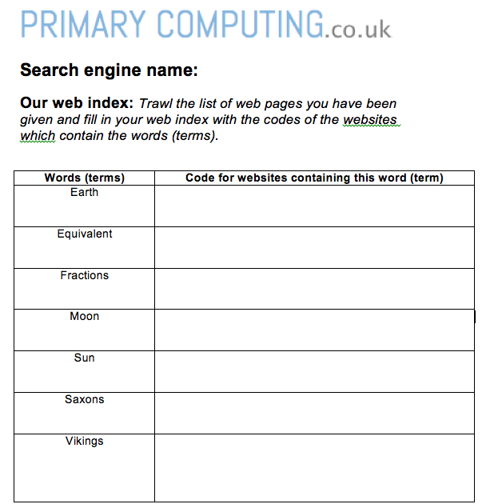
Search engines: ‘appreciate how results are selected’
Activity: setting up your own search engine.
Pupils become web spiders and create their own index of the web
They use this index to respond to searches
Notes:
Powtoon

Slide 8
‘appreciate how results are ranked’
Activity:
Create a ‘webpage’ about frogs!
Notes:
Create content
Add URL
Link to others
Score
SEO

Slide 9
Curriculum + HTML
Mozilla
X-Ray Goggles: https://goggles.webmaker.org/
Thimble: https://thimble.webmaker.org

Slide 10
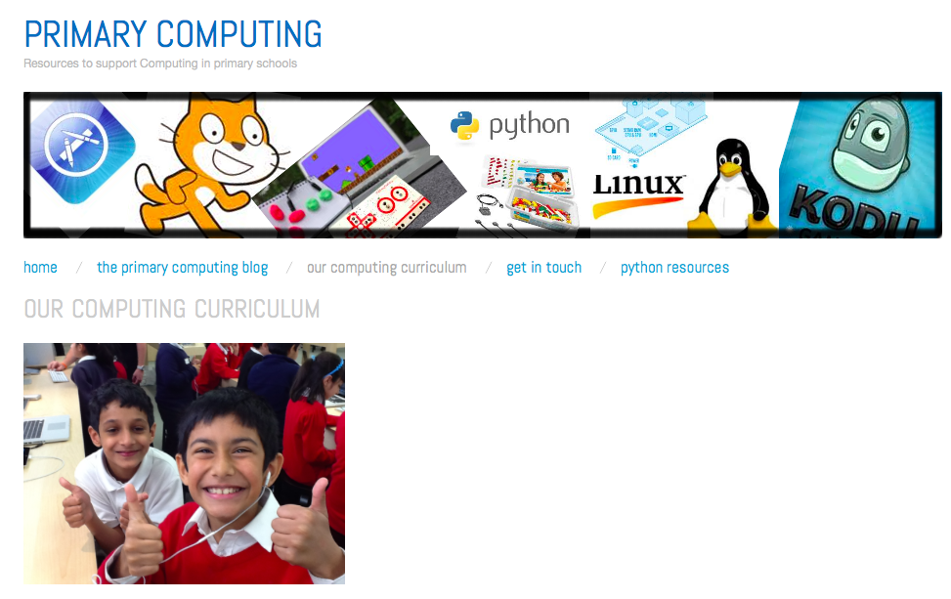
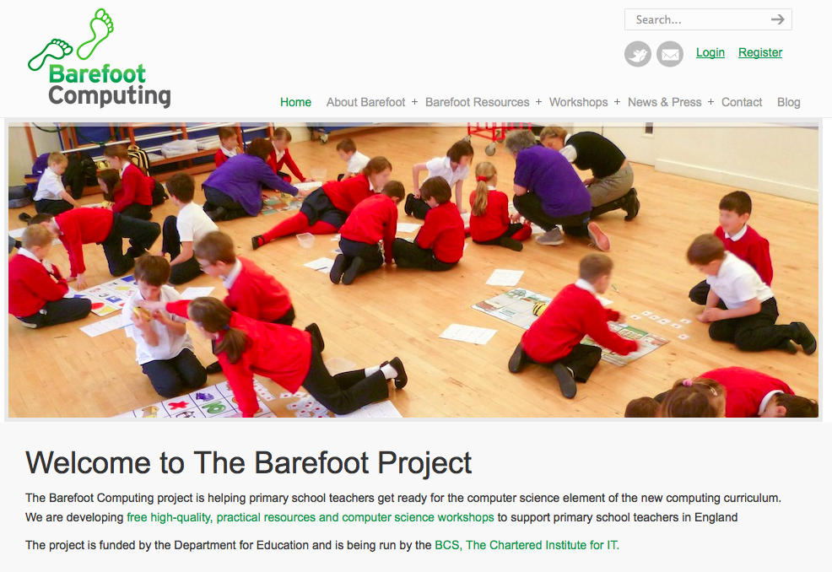
Resources and questions…
www.code-it.co.uk
www.computingatschool.org.uk
www.barefootcas.org.uk

