Slide 1
Assessment of Computing
Jon Chippindall
Crumpsall Lane Primary School
www.primarycomputing.co.uk
CAS Master Teacher
@drchips_
www.barefootcas.org.uk

Slide 2
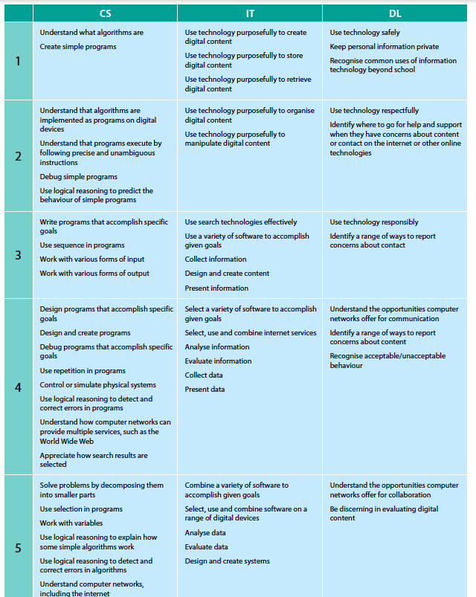
Computing at School: Criteria based approach

Slide 3
Computing at School: Criteria based approach

Slide 4
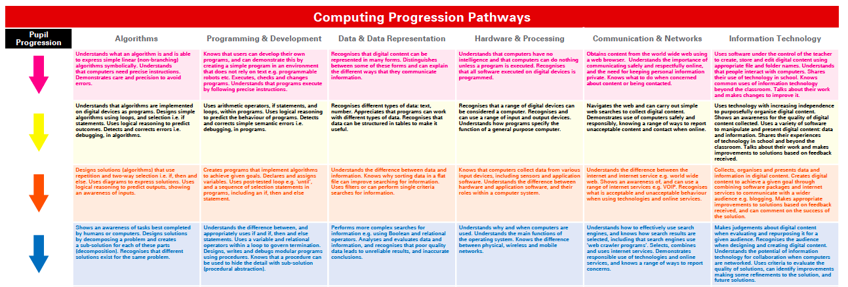
Computing at School: Progression Pathways
Curriculum +
Mapping of computational thinking coming soon

Slide 5
Computing at School: Progression Pathways

Slide 6
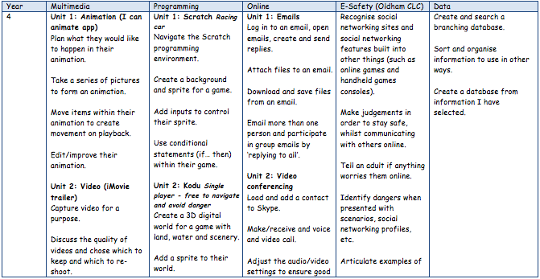
www.crumpsalllaneprimay.org
Exceeded/working towards
Summative and formative tool

Slide 7
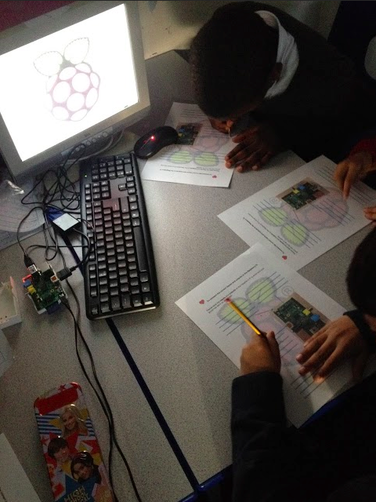
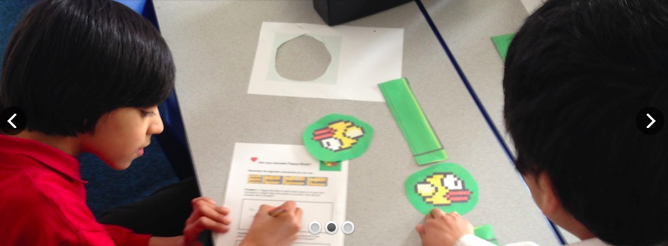
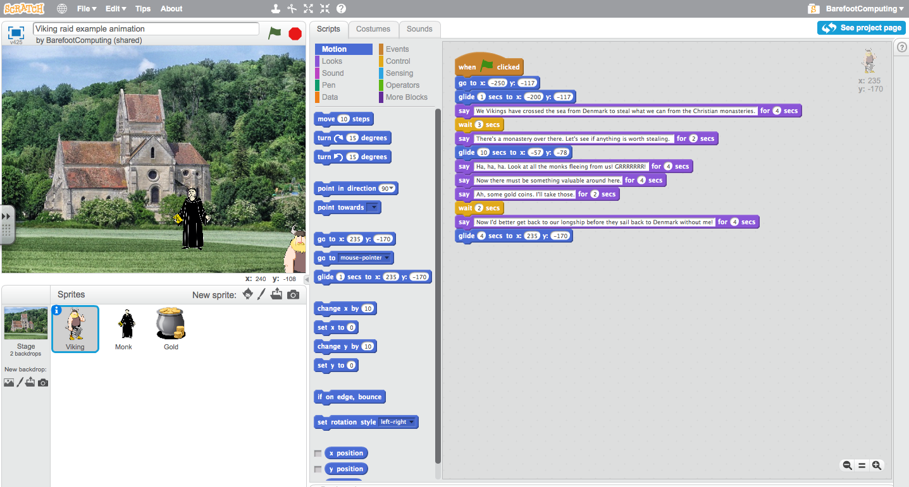
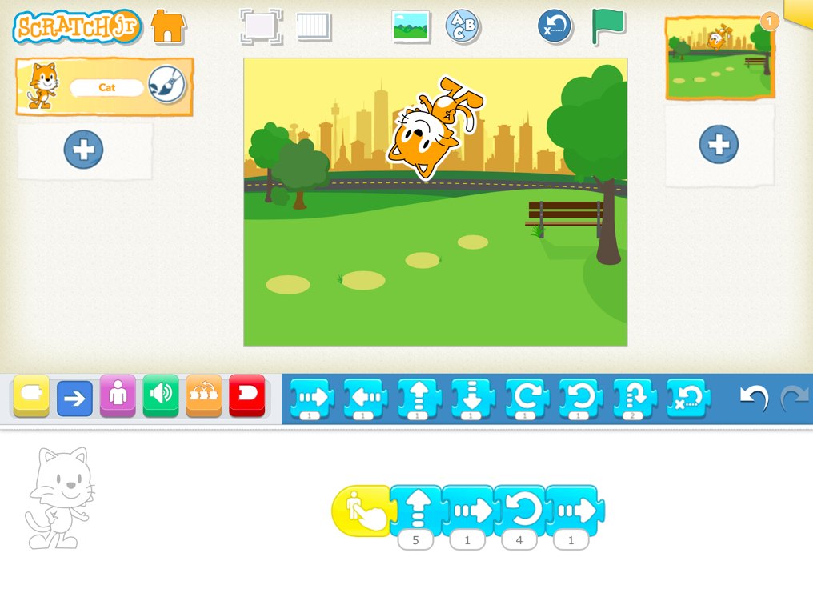
Gathering evidence…
Can pupils apply their skills and understanding?
Games (Scratch 2 online)
Screenshots
Worksheets (design)
Quotes
Blog posts
Photos
Video tutorials

